Slide 1
System Design

Slide 2
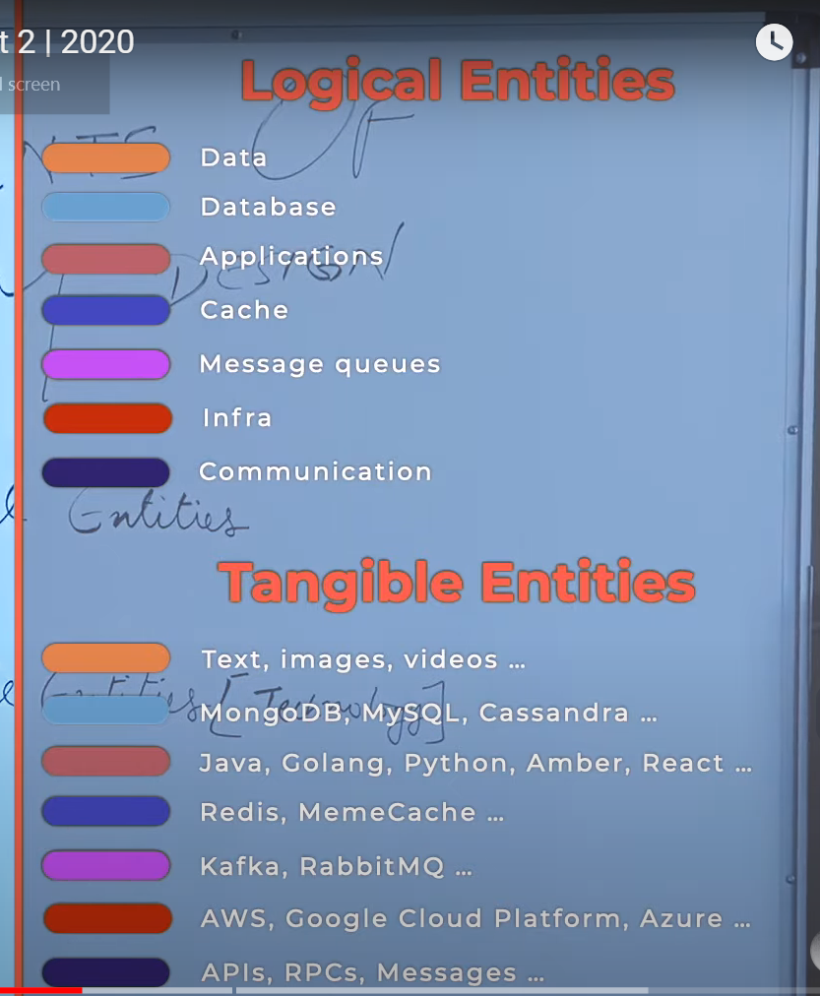
Component of System Design

Slide 3
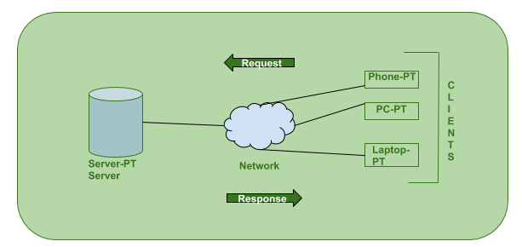
client-server architecture
Client-server architecture, architecture of a computer network in which many clients (remote processors) request and receive service from a centralized server (host computer). Client computers provide an interface to allow a computer user to request services of the server and to display the results the server returns. Servers wait for requests to arrive from clients and then respond to them. Ideally, a server provides a standardized transparent interface to clients so that clients need not be aware of the specifics of the system (i.e., the hardware and software) that is providing the service. Clients are often situated at workstations or on personal computers, while servers are located elsewhere on the network, usually on more powerful machines.

Slide 4
How the Client-Server Model works ?
In this article we are going to take a dive into the Client-Server model and have a look at how the Internet works via, web browsers. This article will help us in having a solid foundation of the WEB and help in working with WEB technologies with ease.
Client: When we talk the word Client, it mean to talk of a person or an organization using a particular service. Similarly in the digital world a Client is a computer (Host) i.e. capable of receiving information or using a particular service from the service providers (Servers).
Servers: Similarly, when we talk the word Servers, It mean a person or medium that serves something. Similarly in this digital world a Server is a remote computer which provides information (data) or access to particular services.
So, its basically the Client requesting something and the Server serving it as long as its present in the database.

Slide 5

How the Client-Server Model works ?

Slide 6
How the browser interacts with the servers ?
There are few steps to follow to interacts with the servers a client.
User enters the URL(Uniform Resource Locator) of the website or file. The Browser then requests the DNS(DOMAIN NAME SYSTEM) Server.
DNS Server lookup for the address of the WEB Server.
DNS Server responds with the IP address of the WEB Server.
Browser sends over an HTTP/HTTPS request to WEB Server’s IP (provided by DNS server).
Server sends over the necessary files of the website.
Browser then renders the files and the website is displayed. This rendering is done with the help of DOM (Document Object Model) interpreter, CSS interpreter and JS Engine collectively known as the JIT or (Just in Time) Compilers.

Slide 7
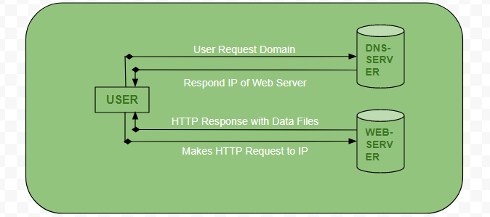
How the browser interacts with the servers ?

Slide 8
Advantages of Client-Server model:
Centralized system with all data in a single place.
Cost efficient requires less maintenance cost and Data recovery is possible.
The capacity of the Client and Servers can be changed separately.

Slide 9
Disadvantages of Client-Server model:
Clients are prone to viruses, Trojans and worms if present in the Server or uploaded into the Server.
Server are prone to Denial of Service (DOS) attacks.
Data packets may be spoofed or modified during transmission.
Phishing or capturing login credentials or other useful information of the user are common and MITM(Man in the Middle) attacks are common.

Slide 10
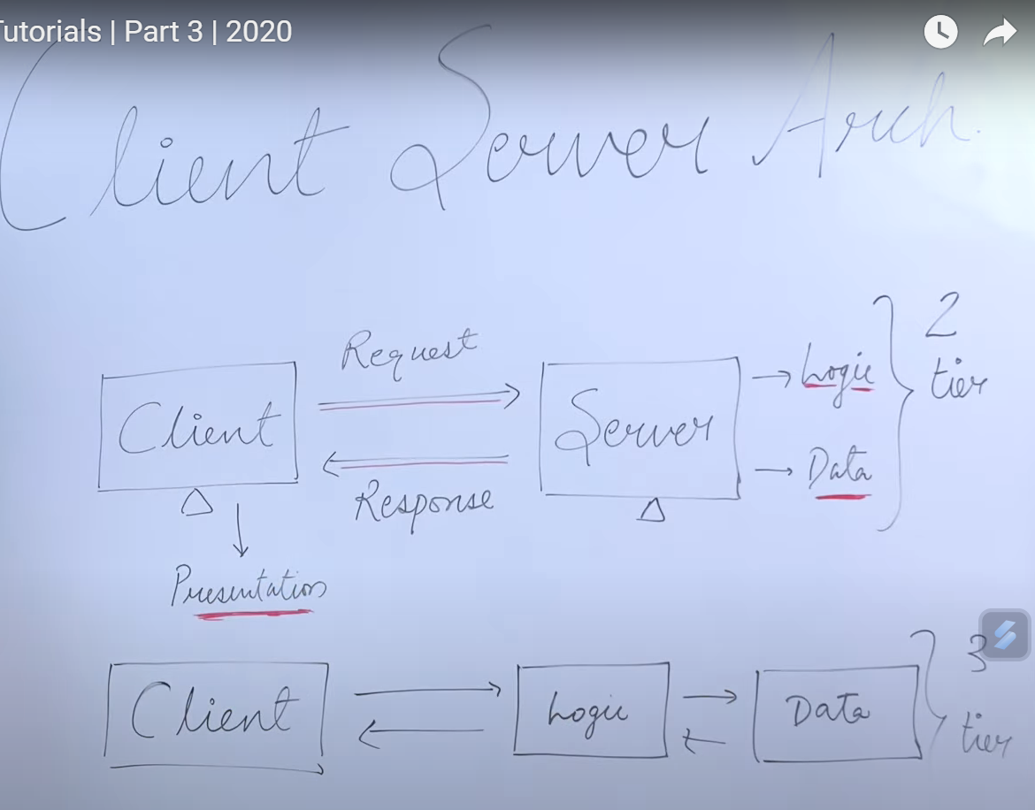

Slide 11
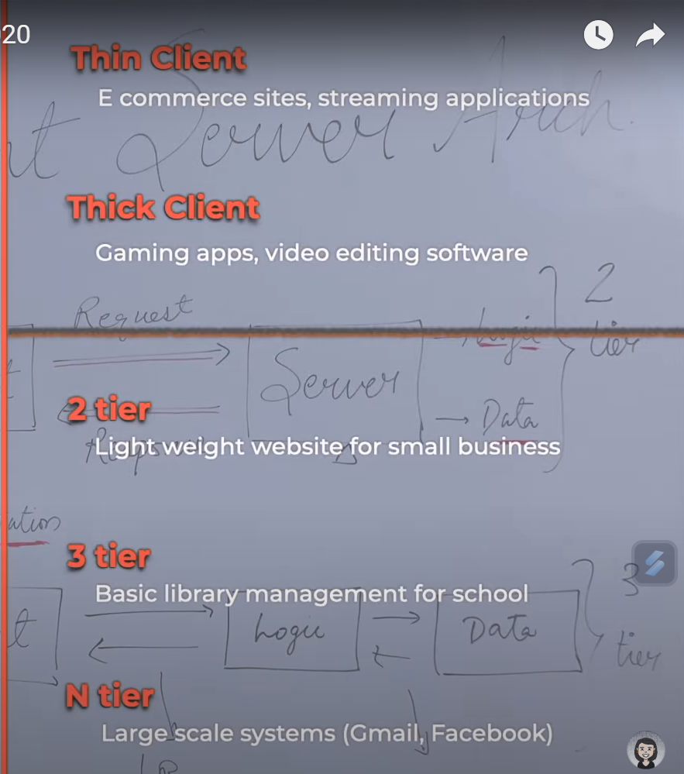

Slide 12
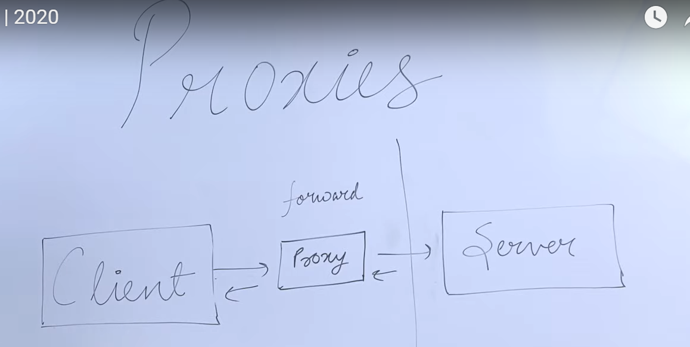
ClientSide proxy is forward Proxy

Slide 13
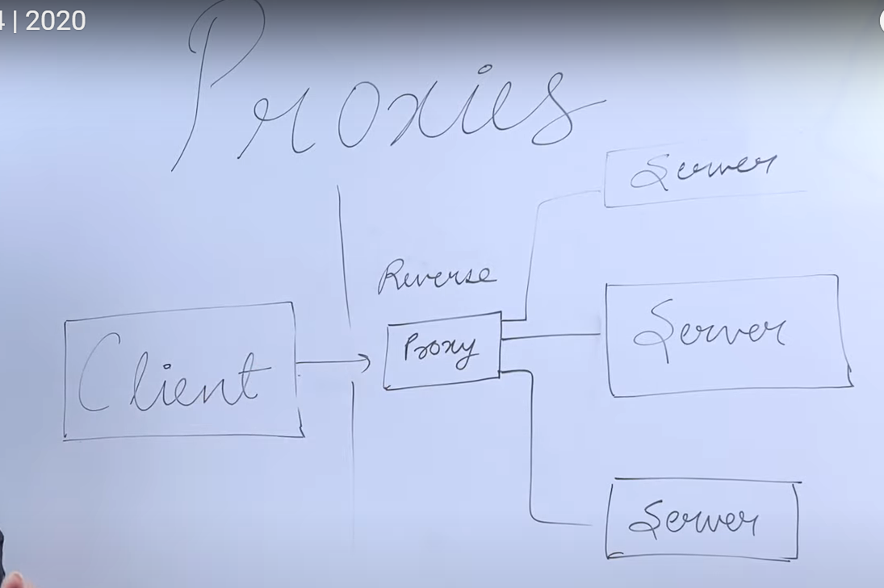
Server Side proxy is forward Proxy

Slide 14
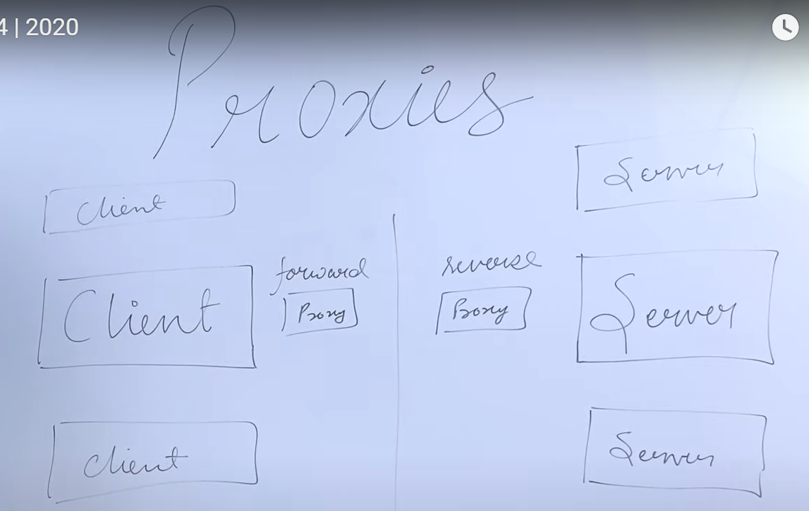

Slide 15
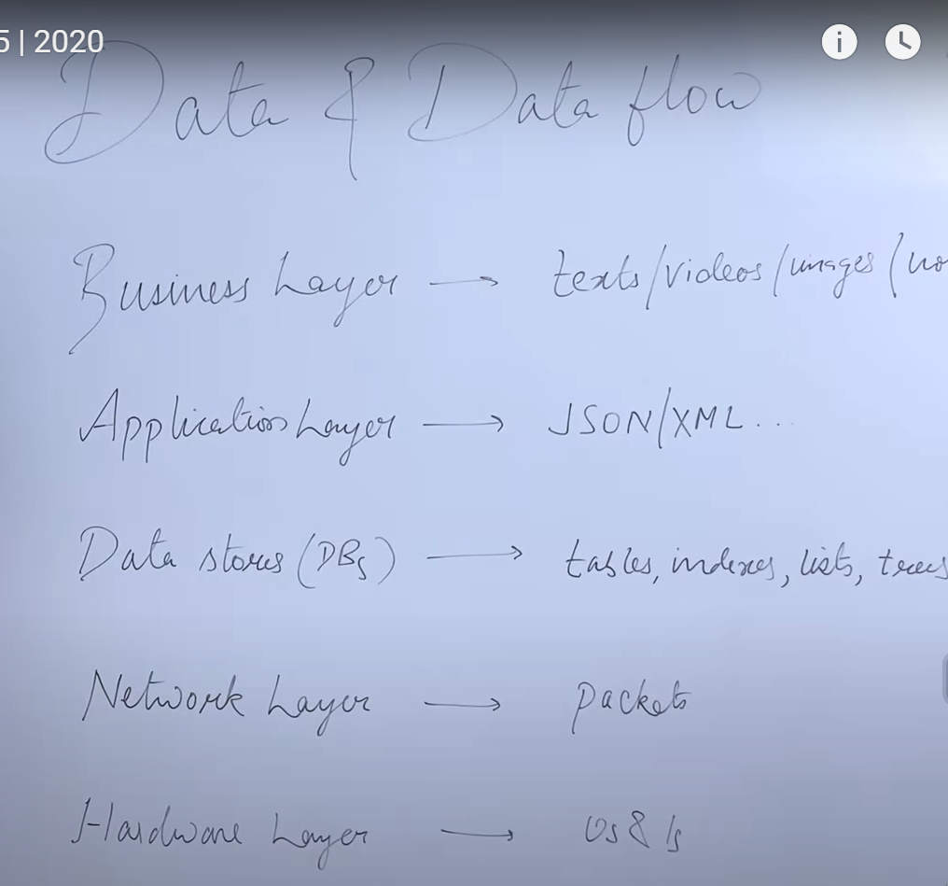

Slide 16
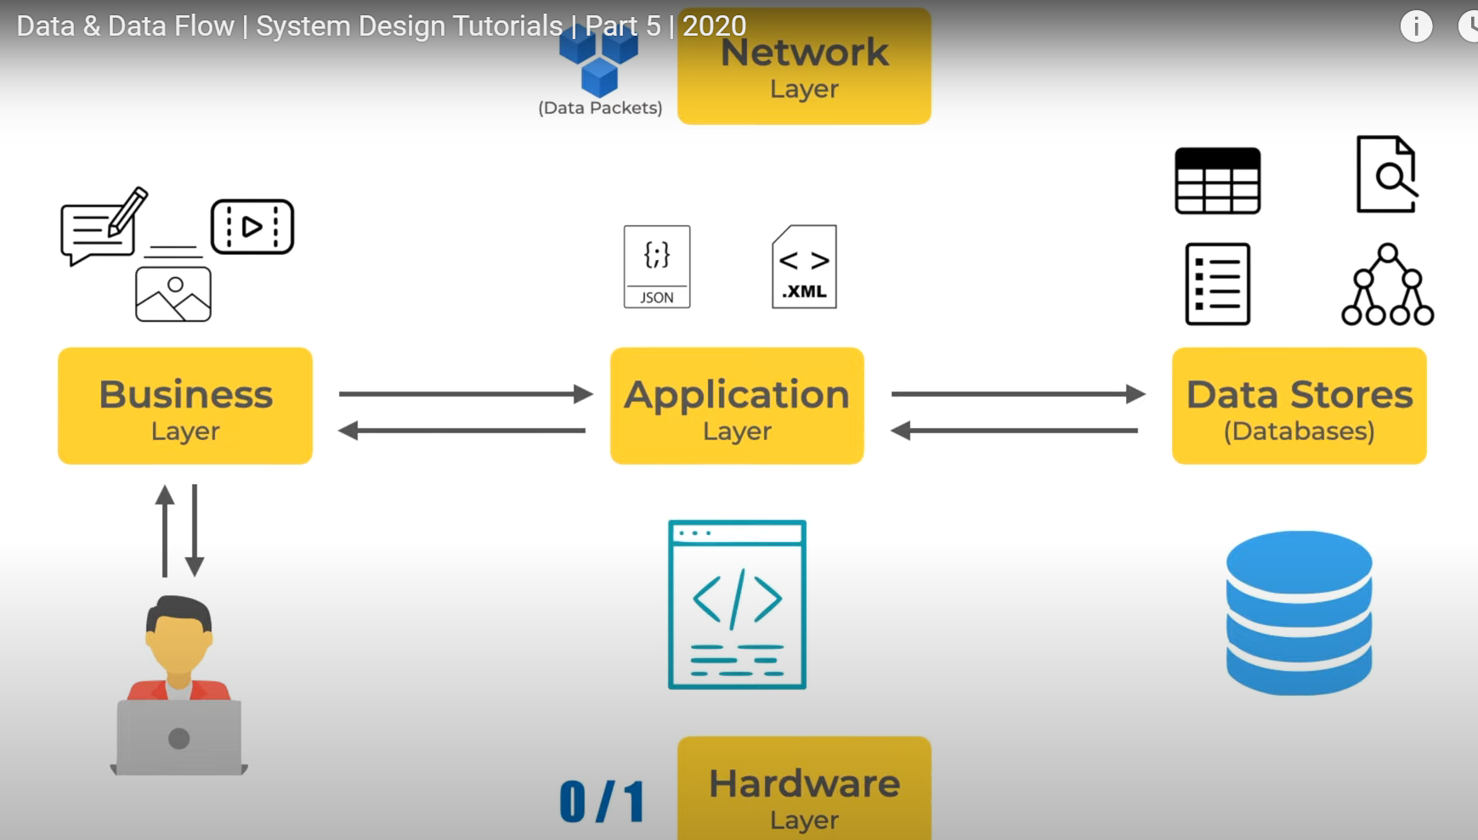

Slide 17


Slide 18
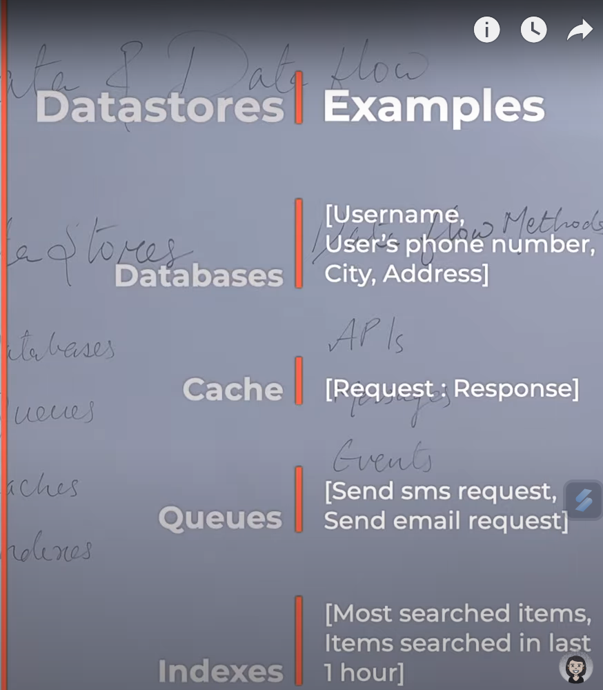

Slide 19
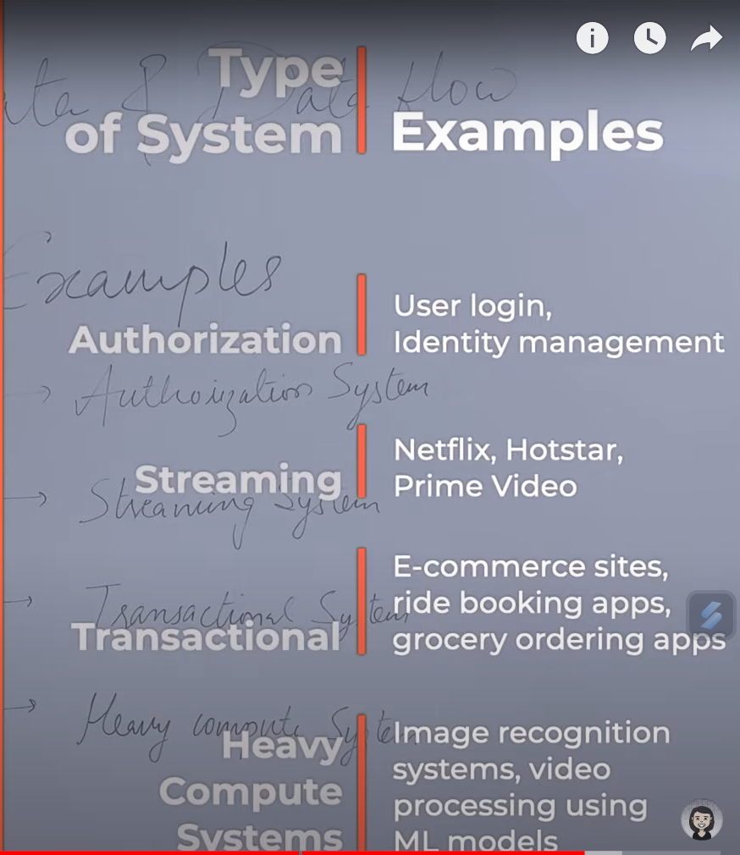

Slide 20
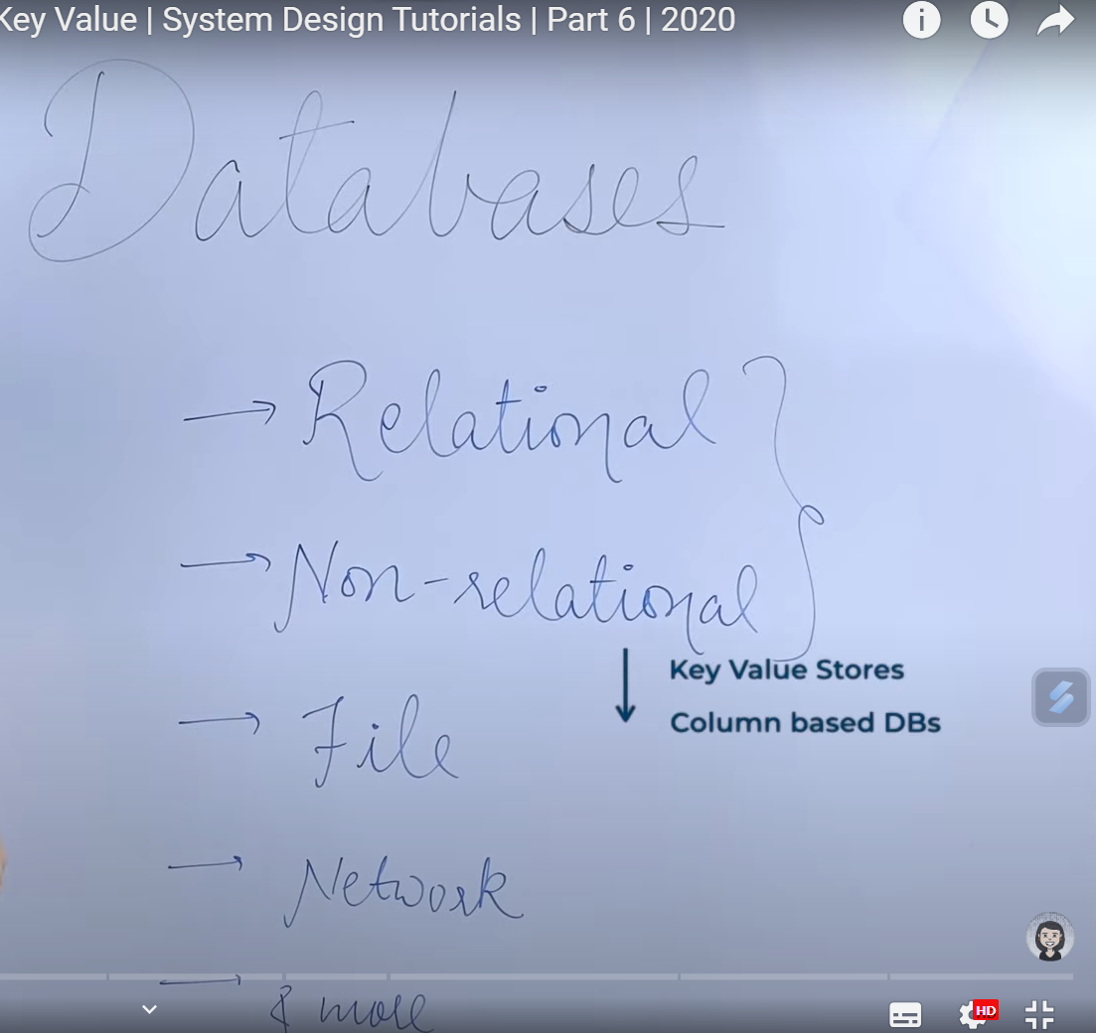

Slide 21
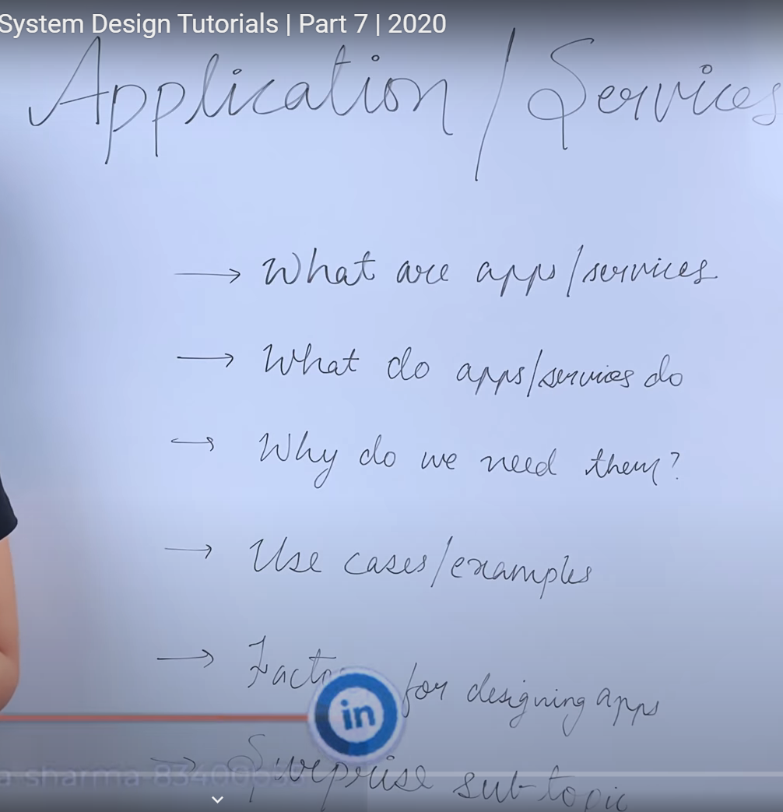

Slide 22
